Slide 1
NLP Core using NLTK
Dr. Muhammad Nouman Durrani

Slide 2
Tokenization
The process of breaking down a text paragraph into smaller chunks such as words or sentences is called Tokenization
Token is a single entity that is building blocks for sentence or paragraph
Sentence Tokenization
Sentence tokenizer breaks text paragraph into sentences
from nltk.tokenize import sent_tokenize
text="""Hello Mr. Smith, how are you doing today? The weather is great, and city is awesome. The sky is pinkish-blue. You shouldn't eat cardboard"""
tokenized_text=sent_tokenize(text)
print(tokenized_text)
['Hello Mr. Smith, how are you doing today?', 'The weather is great, and city is awesome.', 'The sky is pinkish-blue.', "You shouldn't eat cardboard"]

Slide 3
Tokenization
Word Tokenization
Word tokenizer breaks text paragraph into words
from nltk.tokenize import word_tokenize
tokenized_word=word_tokenize(text)
print(tokenized_word)
['Hello', 'Mr.', 'Smith', ',', 'how', 'are', 'you', 'doing', 'today', '?', 'The', 'weather', 'is', 'great', ',', 'and', 'city', 'is', 'awesome', '.', 'The', 'sky', 'is', 'pinkish-blue', '.', 'You', 'should', "n't", 'eat', 'cardboard']

Slide 4
Tokenization
Frequency Distribution
from nltk.probability import FreqDist
fdist = FreqDist(tokenized_word)
print(fdist)
<FreqDist with 25 samples and 30 outcomes>
fdist.most_common(2)
[('is', 3), (',', 2)]

Slide 5
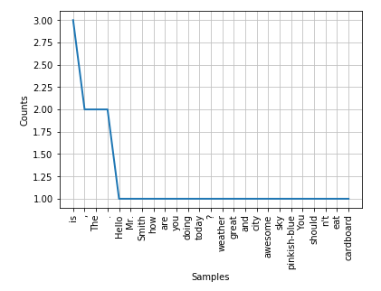
Tokenization
Frequency Distribution Plot
import matplotlib.pyplot as plt
fdist.plot(30,cumulative=False)
plt.show()

Slide 6
Tokenize Non-English Languages Text
To tokenize other languages, you can specify the language like this:
from nltk.tokenize import sent_tokenize
mytext = "Bonjour M. Adam, comment allez-vous? J'espère que tout va bien. Aujourd'hui est un bon jour."
print(sent_tokenize(mytext, "french"))
The result will be like this:
['Bonjour M. Adam, comment allez-vous?', "J'espère que tout va bien.", "Aujourd'hui est un bon jour."]

Slide 7
Stopwords
Stopwords considered as noise in the text. Text may contain stop words such as is, am, are, this, a, an, the, etc.
In NLTK for removing stopwords, you need to create a list of stopwords and filter out your list of tokens from these words
from nltk.corpus import stopwords
stop_words=set(stopwords.words("english"))
print(stop_words)
{'their', 'then', 'not', 'ma', 'here', 'other', 'won', 'up', 'weren', 'being', 'we', 'those', 'an', 'them', 'which', 'him', 'so', 'yourselves', 'what', 'own', 'has', 'should', 'above', 'in', 'myself', 'against', 'that', 'before', 't', 'just', 'into', 'about', 'most', 'd', 'where', 'our', 'or', 'such', 'ours', 'of', 'doesn', 'further', 'needn', 'now', 'some', 'too', 'hasn', 'more', 'the', 'yours', 'her', 'below', 'same', 'how', 'very', 'is', 'did', 'you', 'his', 'when', 'few', 'does', 'down', 'yourself', 'i', 'do', 'both', 'shan', 'have', 'itself', 'shouldn', 'through', 'themselves', 'o', 'didn', 've', 'm', 'off', 'out', 'but', 'and', 'doing', 'any', 'nor', 'over', 'had', 'because', 'himself', 'theirs', 'me', 'by', 'she', 'whom', 'hers', 're', 'hadn', 'who', 'he', 'my', 'if', 'will', 'are', 'why', 'from', 'am', 'with', 'been', 'its', 'ourselves', 'ain', 'couldn', 'a', 'aren', 'under', 'll', 'on', 'y', 'can', 'they', 'than', 'after', 'wouldn', 'each', 'once', 'mightn', 'for', 'this', 'these', 's', 'only', 'haven', 'having', 'all', 'don', 'it', 'there', 'until', 'again', 'to', 'while', 'be', 'no', 'during', 'herself', 'as', 'mustn', 'between', 'was', 'at', 'your', 'were', 'isn', 'wasn'}

Slide 8
Stopwords
filtered_sent=[]
for w in tokenized_sent:
if w not in stop_words:
filtered_sent.append(w)
print("Tokenized Sentence:",tokenized_sent)
print("Filterd Sentence:",filtered_sent)
Tokenized Sentence: ['Hello', 'Mr.', 'Smith', ',', 'how', 'are', 'you', 'doing', 'today', '?’]
Filterd Sentence: ['Hello', 'Mr.', 'Smith', ',', 'today', '?']

Slide 9
Get Synonyms From WordNet
WordNet is a database built for natural language processing
It includes groups of synonyms and a brief definition
from nltk.corpus import wordnet
syn = wordnet.synsets("pain")
print(syn[0].definition())
print(syn[0].examples())
a symptom of some physical hurt or disorder
['the patient developed severe pain and distension']

Slide 10
Get Synonyms From WordNet
You can use WordNet to get synonymous words like this:
from nltk.corpus import wordnet
synonyms = []
for syn in wordnet.synsets('Computer'):
for lemma in syn.lemmas():
synonyms.append(lemma.name())
print(synonyms)
The output is:
['computer', 'computing_machine', 'computing_device', 'data_processor', 'electronic_computer', 'information_processing_system', 'calculator', 'reckoner', 'figurer', 'estimator', 'computer']

Slide 11
Get Antonyms From WordNet
You can get the antonyms of words the same way
Use the lemmas before adding them to the array
it's an antonym or not
from nltk.corpus import wordnet
antonyms = []
for syn in wordnet.synsets("small"):
for l in syn.lemmas():
if l.antonyms():
antonyms.append(l.antonyms()[0].name())
print(antonyms)
['large', 'big', 'big']

Slide 12
NLTK Word Stemming
Word stemming means removing affixes from words and returning the root word. (The stem of the word working is work.)
Search engines use this technique when indexing pages, so many people write different versions for the same word and all of them are stemmed to the root word
NLTK has a class called PorterStemmer that uses this algorithm.
from nltk.stem import PorterStemmer
stemmer = PorterStemmer()
print(stemmer.stem('working’))
The result is: work.

Slide 13
Lemmatizing Words Using WordNet
Word lemmatizing is similar to stemming, but the difference is the result of lemmatizing is a real word
When we stem some words, it will result as follows:
from nltk.stem import PorterStemmer
stemmer = PorterStemmer()
print(stemmer.stem('increases’))
The result is: increas.
When we lemmatize the same word using NLTK WordNet, the result is increase:
from nltk.stem import WordNetLemmatizer
lemmatizer = WordNetLemmatizer()
print(lemmatizer.lemmatize('increases'))
The result is increase.

Slide 14
Lemmatizing Words Using WordNet
If we try to lemmatize a word like “playing”, it will end up with the same word
This is because the default part of speech is nouns
To get verbs, adjective, or adverb, we should specify it (See Example)
Actually, this is a very good level of text compression.
We end up with about 50% to 60% compression
from nltk.stem import WordNetLemmatizer
lemmatizer = WordNetLemmatizer()
print(lemmatizer.lemmatize('playing', pos="v"))
print(lemmatizer.lemmatize('playing', pos="n"))
print(lemmatizer.lemmatize('playing', pos="a"))
print(lemmatizer.lemmatize('playing', pos="r"))
The result is:
play
playing
playing
playing

Slide 15
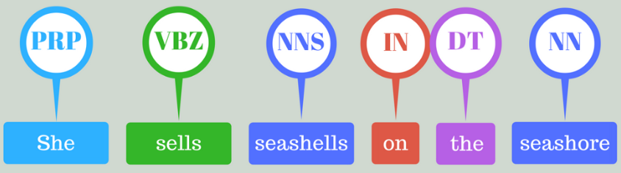
Part of speech tagging (POS)
Part-of-speech tagging is used to assign parts of speech to each word of a given text (such as nouns, verbs, pronouns, adverb, conjunction, adjectives, interjection) based on its definition and its context.
text = “vote to choose a particular man or a group (party) to represent them in parliament”
tex = word_tokenize(text) #Tokenize the text
for token in tex:
print(nltk.pos_tag([token]))
[('vote', 'NN')]
[('to', 'TO')]
[('choose', 'NN')]
[('a', 'DT')]
[('particular', 'JJ')]
[('man', 'NN')]
[('or', 'CC')]
[('a', 'DT')]
[('group', 'NN')]
[('(', '(')]
[('party', 'NN')]
[(')', ')')]
[('to', 'TO')]
[('represent', 'NN')]
[('them', 'PRP')]
[('in', 'IN')]
[('parliament', 'NN')]

Slide 16
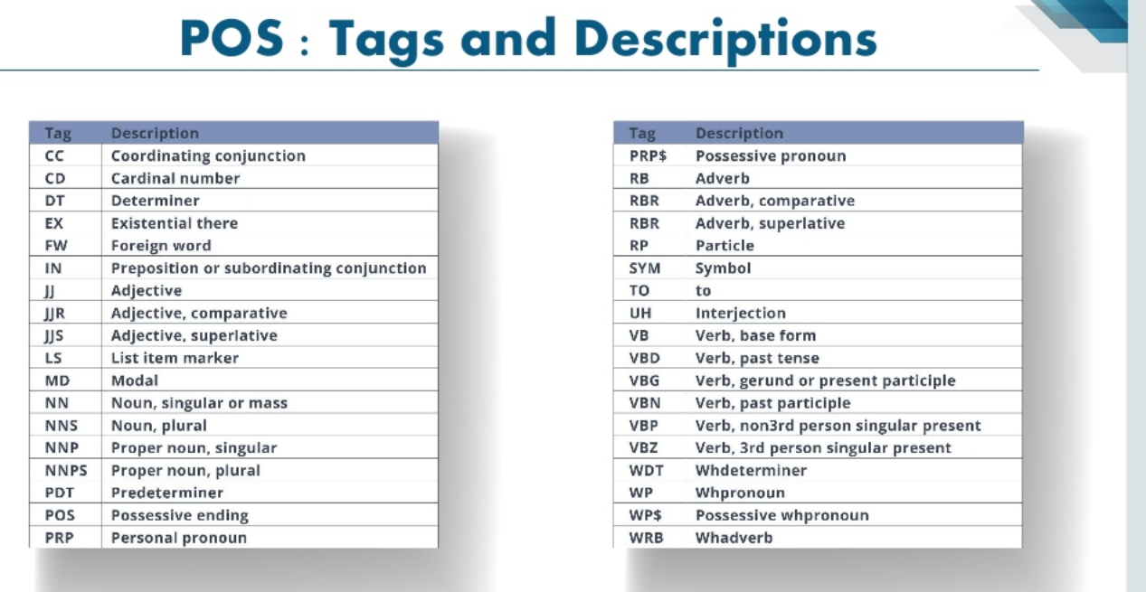

Slide 17
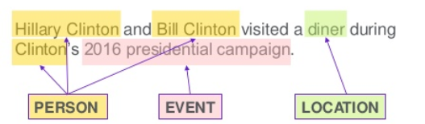
Named entity recognition
It is the process of detecting the named entities such as the person name, the location name, the company name, the quantities and the monetary value.
text = “Google’s CEO Sundar Pichai introduced the new Pixel at Minnesota Roi Centre Event” #importing chunk library from nltk
from nltk import ne_chunk # tokenize and POS Tagging before doing chunk
token = word_tokenize(text)
tags = nltk.pos_tag(token)
chunk = ne_chunk(tags)
chunk

Slide 18
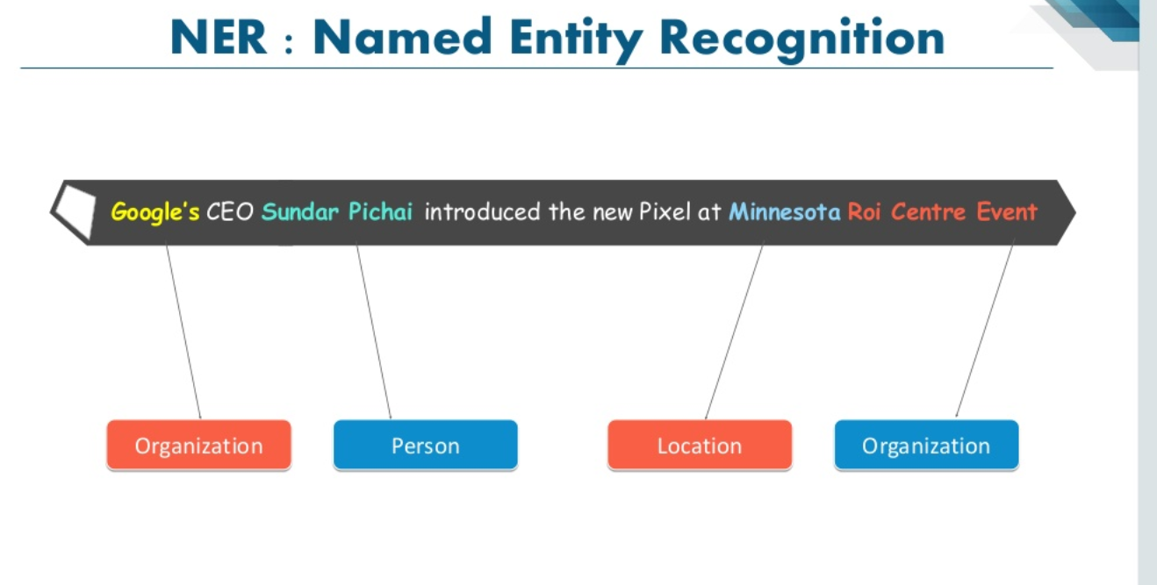

Slide 19
POS Tagging Output:
Tree('S', [Tree('GPE', [('Google', 'NNP')]), ("'s", 'POS'), Tree('ORGANIZATION', [('CEO', 'NNP'), ('Sundar', 'NNP'), ('Pichai', 'NNP')]), ('introduced', 'VBD'), ('the', 'DT'), ('new', 'JJ'), ('Pixel', 'NNP'), ('at', 'IN'), Tree('ORGANIZATION', [('Minnesota', 'NNP'), ('Roi', 'NNP'), ('Centre', 'NNP')]), ('Event', 'NNP')])

Slide 20
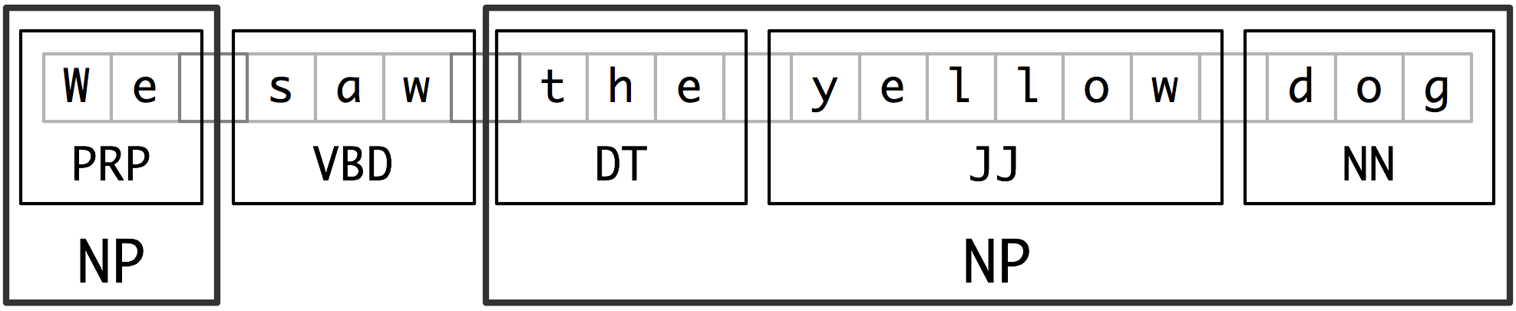
Chunking
Chunking means picking up individual pieces of information and grouping them into bigger pieces.
In the context of NLP and text mining, chunking means grouping of words or tokens into chunks.
text = “We saw the yellow dog”
token = word_tokenize(text)
tags = nltk.pos_tag(token)
reg = “NP: {<DT>?<JJ>*<NN>}”
a = nltk.RegexpParser(reg)
result = a.parse(tags)
print(result)
(S We/PRP saw/VBD (NP the/DT yellow/JJ dog/NN))

Slide 21
What are Word Embeddings?
Word Embeddings are the texts converted into numbers
There may be different numerical representations of the same text.
Why do we need Word Embeddings?
Many Machine Learning algorithms and almost all Deep Learning Architectures are incapable of processing strings or plain text in their raw form
With huge amount of data that is present in the text format, it is imperative to extract knowledge out of it and build applications
They require numbers as inputs to perform any sort of job, be it classification, regression etc. in broad terms
Some real world applications of text applications are – sentiment analysis of reviews by Amazon etc., document or news classification or clustering by Google etc.
A Word Embedding format generally tries to map a word using a dictionary to a vector

Slide 22
What are Word Embeddings?
Take a look at this example – sentence=” Word Embeddings are Word converted into numbers ”
A word in this sentence may be “Embeddings” or “numbers ” etc.
A dictionary may be the list of all unique words in the sentence.
So, a dictionary may look like – [‘Word’,’Embeddings’,’are’,’Converted’,’into’,’numbers’]
A vector representation of a word may be a one-hot encoded vector where 1 stands for the position where the word exists and 0 everywhere else.
The vector representation of “numbers” in this format according to the above dictionary is [0,0,0,0,0,1] and of “converted” is[0,0,0,1,0,0].

Slide 23
1. One-hot encoding (CountVectorizing)
The most basic and naive method for transforming words into vectors is to count occurrence of each word in each document. Such an approach is called countvectorizing or one-hot encoding.
The idea is to collect a set of documents (they can be words, sentences, paragraphs or even articles) and count the occurrence of every word in them
The columns of the resulting matrix are words and the rows are documents

Slide 24
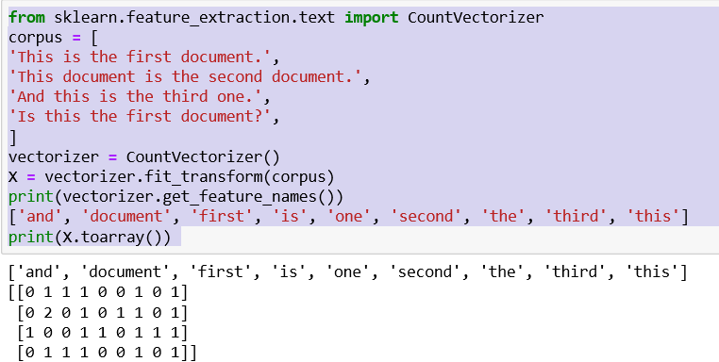
Example I

Slide 25
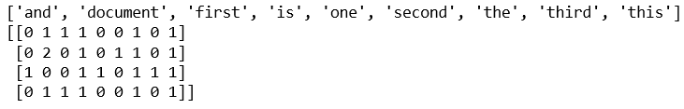
Example I
from sklearn.feature_extraction.text import CountVectorizer
corpus = [
'This is the first document.',
'This document is the second document.',
'And this is the third one.',
'Is this the first document?',
]
vectorizer = CountVectorizer()
X = vectorizer.fit_transform(corpus)
print(vectorizer.get_feature_names())
['and', 'document', 'first', 'is', 'one', 'second', 'the', 'third', 'this']
print(X.toarray())

Slide 26
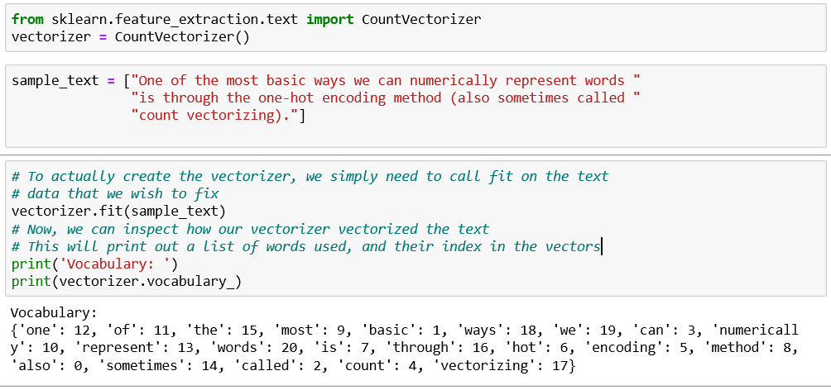
Example II

Slide 27
Example II
from sklearn.feature_extraction.text import CountVectorizer
vectorizer = CountVectorizer()
sample_text = ["One of the most basic ways we can numerically represent words "
"is through the one-hot encoding method (also sometimes called "
"count vectorizing)."]
# To actually create the vectorizer, we simply need to call fit on the text
# data that we wish to fix
vectorizer.fit(sample_text)
# Now, we can inspect how our vectorizer vectorized the text
# This will print out a list of words used, and their index in the vectors
print('Vocabulary: ')
print(vectorizer.vocabulary_)

Slide 28
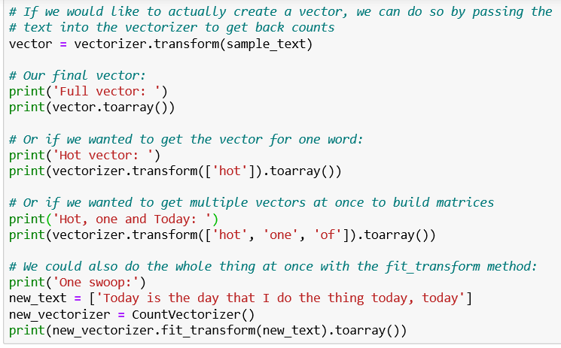
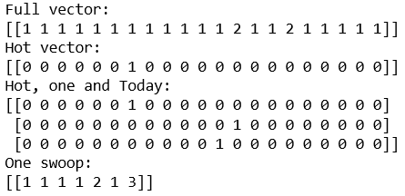

Slide 29
Example II
# If we would like to actually create a vector, we can do so by passing the
# text into the vectorizer to get back counts
vector = vectorizer.transform(sample_text)
# Our final vector:
print('Full vector: ')
print(vector.toarray())
# Or if we wanted to get the vector for one word:
print('Hot vector: ')
print(vectorizer.transform(['hot']).toarray())
# Or if we wanted to get multiple vectors at once to build matrices
print('Hot, one and Today: ')
print(vectorizer.transform(['hot', 'one', 'of']).toarray())

Slide 30
Example II
# We could also do the whole thing at once with the fit_transform method:
print('One swoop:')
new_text = ['Today is the day that I do the thing today, today']
new_vectorizer = CountVectorizer()
print(new_vectorizer.fit_transform(new_text).toarray())

Slide 31
2. Bag of Words (BOW)
A bag-of-words is a representation of text that describes the occurrence (as one-hot-encoded vector or count vectorizer) of words within a document.
It involves two things:
A vocabulary of known words.
A measure of the presence of known words.
The intuition is that documents are similar if they have similar content.
It is called a bag-of-words , because any information about the order or structure of words in the document is discarded.
The model is only concerned with whether known words occur in the document, not where in the document.

Slide 32
2. Bag of Words (BOW)
Bag of words models encode every word in the vocabulary as one-hot-encoded vector
For vocabulary of size |V|, each word is represented by a |V| dimensional sparse vector with 1 at index corresponding to the word and 0 at every other index.
As vocabulary may potentially run into millions, bag of word models face scalability challenges.
Bag of Words is a method to extract features from text documents.
These features can be used for training machine learning algorithms.
It creates a vocabulary of all unique words occurring in all the documents in training set.
BOW is an approach widely used with:
Natural language processing
Information retrieval from documents
Document classifications

Slide 33
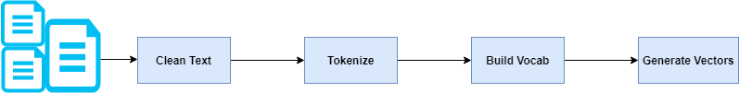
2. BOW
Consider the below two sentences.
1. "John likes to watch movies. Mary likes movies too.“ and 2. "John also likes to watch football games."
These two sentences can be also represented with a collection of words.
1. ['John', 'likes', 'to', 'watch', 'movies.', 'Mary', 'likes', 'movies', 'too.']
2. ['John', 'also', 'likes', 'to', 'watch', 'football', 'games']
Further, for each sentence, remove multiple occurrences of the word and use the word count to represent this.
1. {"John":1,"likes":2,"to":1,"watch":1,"movies":2,"Mary":1,"too":1}
2. {"John":1,"also":1,"likes":1,"to":1,"watch":1,"football":1, "games":1}
Assuming these sentences are part of a document, below is the combined word frequency for our entire document. Both sentences are taken into account.
{"John":2,"likes":3,"to":2,"watch":2,"movies":2,"Mary":1,"too":1, "also":1,"football":1,"games":1}

Slide 34
2. BOW
The length of the vector will always be equal to vocabulary size.
In this case the vector length is 11.
bagofwords(“John likes to watch movies. Mary likes movies too.”, vocabulary)
is [1, 2, 1, 1, 2, 1, 1, 0, 0, 0]
bagofwords (“John also likes to watch football games.”, vocabulary)
is [1, 1, 1, 1, 0, 0, 0, 1, 1, 1]

Slide 35
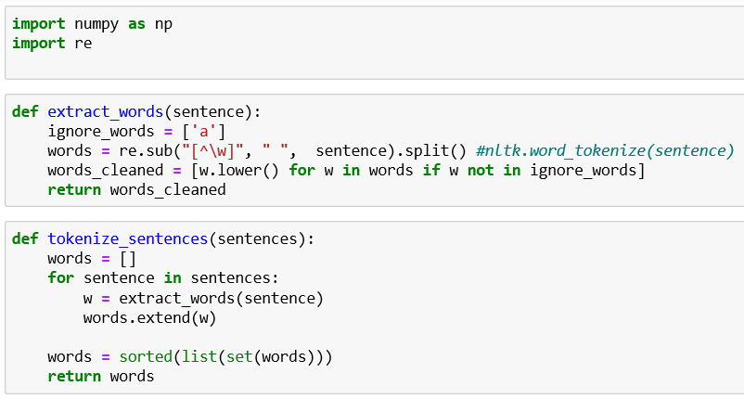

Slide 36
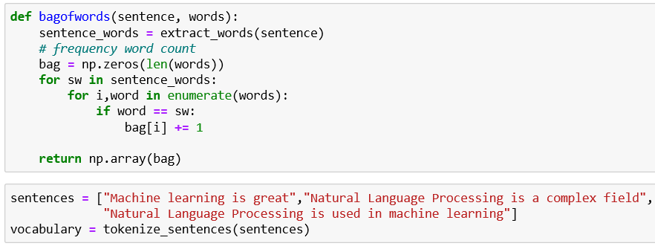


Slide 37
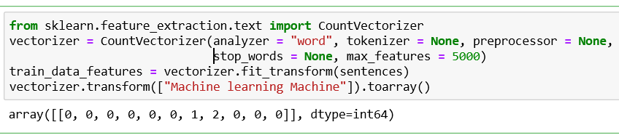
CountVectorizer

Slide 38
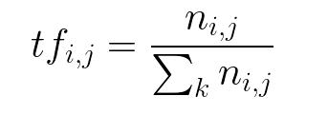

3. Word Frequencies with TfidfVectorizer
Word counts are a good starting point, but are very basic
One issue with simple counts is that some words like “the” will appear many times and their large counts will not be very meaningful in the encoded vectors
TF-IDF feature numerical representations where words are represented by their term frequency multiplied by their inverse document frequency
Term Frequency: This summarizes how often a given word appears within a document.
The number of times a word appears in a document divided by the total number of words in the document.
Every document has its own term frequency.

Slide 39
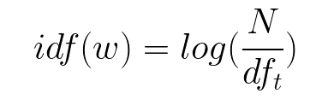
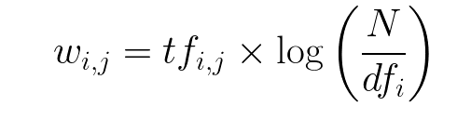
3. Word Frequencies with TfidfVectorizer
Inverse Document Frequency: The log of the number of documents divided by the number of documents that contain the word w
Inverse document frequency determines the weight of rare words across all documents in the corpus
This downscales words that appear a lot across documents
Combining these two we come up with the TF-IDF score (w) for a word in a document in the corpus.
It is the product of tf and idf:
TF-IDF are word frequency scores that try to highlight words that are more interesting, e.g. frequent in a document but not across documents

Slide 40
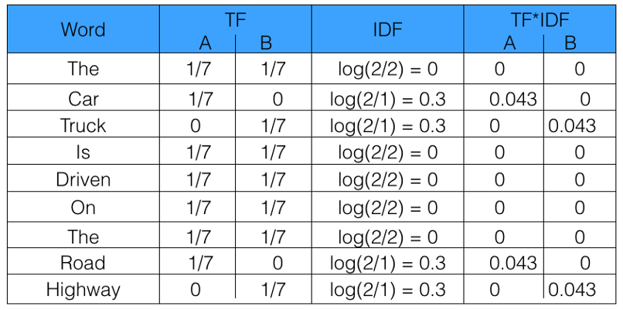
3. Word Frequencies with TfidfVectorizer
Let’s take an example to get a clearer understanding.
Sentence 1 : The car is driven on the road.
Sentence 2: The truck is driven on the highway.
In this example, each sentence is a separate document.
Calculate the TF-IDF for the above two documents, which represent our corpus.

Slide 41
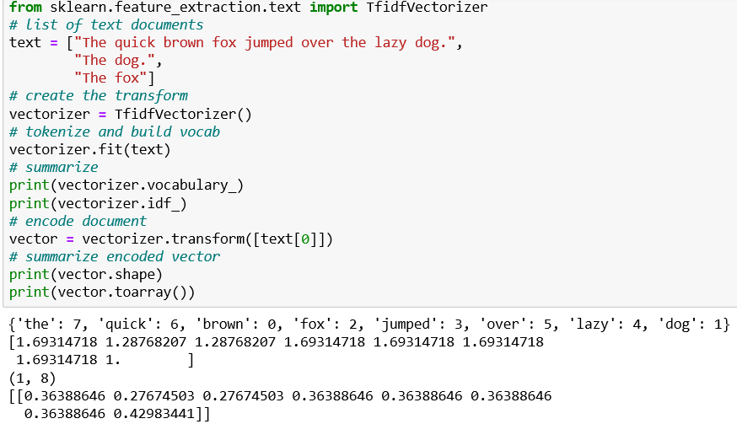
The TfidfVectorizer will tokenize documents, learn the vocabulary and inverse document frequency weightings, and allow you to encode new documents.

Slide 42
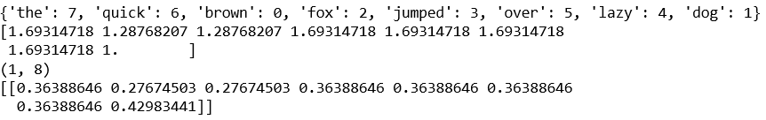
3. Word Frequencies with TfidfVectorizer
from sklearn.feature_extraction.text import TfidfVectorizer
# list of text documents
text = ["The quick brown fox jumped over the lazy dog.",
"The dog.",
"The fox"]
# create the transform
vectorizer = TfidfVectorizer()
# tokenize and build vocab
vectorizer.fit(text)
# summarize
print(vectorizer.vocabulary_)
print(vectorizer.idf_)
# encode document
vector = vectorizer.transform([text[0]])
# summarize encoded vector
print(vector.shape)
print(vector.toarray())

Slide 43
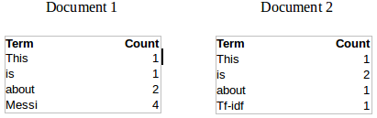
How exactly does TF-IDF work?
Sample tables give the count of terms(tokens/words) in two documents
TF = (Number of times term t appears in a document)/(Number of terms in the document)
TF(This,Document1) = 1/8
TF(This, Document2)=1/5
It denotes the contribution of the word to the document i.e words relevant to the document should be frequent
For Example: A document about Messi should contain the word ‘Messi’ in large number

Slide 44
How exactly does TF-IDF work?
IDF = log(N/n), where, N is the number of documents and n is the number of documents a term t has appeared in.
IDF(This) = log(2/2) = 0.
How do we explain the reasoning behind IDF? Ideally, if a word has appeared in all the document, then probably that word is not relevant to a particular document
But if it has appeared in a subset of documents then probably the word is of some relevance to the documents it is present in
Let us compute IDF for the word ‘Messi’.
IDF(Messi) = log(2/1) = 0.301.
Now, let us compare the TF-IDF for a common word ‘This’ and a word ‘Messi’
TF-IDF(This,Document1) = (1/8) * (0) = 0 TF-IDF(This, Document2) = (1/5) * (0) = 0
TF-IDF(Messi, Document1) = (4/8)*0.301 = 0.15
For Document1, TF-IDF method heavily penalizes the word ‘This’ but assigns greater weight to ‘Messi’.
So, ‘Messi’ is an important word for Document1 from the context of the entire corpus

Slide 45
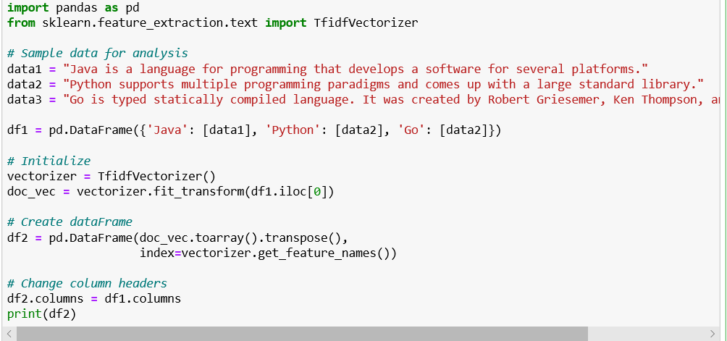
3. Word Frequencies with TfidfVectorizer
Notes:
Convert a collection of raw documents to a matrix of TF-IDF features. TfidfTransformer applies Term Frequency Inverse Document Frequency normalization to a sparse matrix of occurrence counts. However, CountVectorizer tokenize the documents and count the occurrences of token and return them as a sparse matrix.
<number>

Slide 46
TF-IDF Example
import pandas as pd
from sklearn.feature_extraction.text import TfidfVectorizer
# Sample data for analysis
data1 = "Java is a language for programming that develops a software for several platforms.”
data2 = "Python supports multiple programming paradigms and comes up with a large standard library.”
data3 = "Go is typed statically compiled language. It was created by Robert Griesemer, Ken Thompson, and”
“Rob Pike in 2009.”
df1 = pd.DataFrame({'Java': [data1], 'Python': [data2], 'Go': [data2]})
vectorizer = TfidfVectorizer() # Initialize
doc_vec = vectorizer.fit_transform(df1.iloc[0])
# Create dataFrame
df2 = pd.DataFrame(doc_vec.toarray().transpose(),index=vectorizer.get_feature_names())
df2.columns = df1.columns # Change column headers
print(df2)
Notes:
Convert a collection of raw documents to a matrix of TF-IDF features. TfidfTransformer applies Term Frequency Inverse Document Frequency normalization to a sparse matrix of occurrence counts. However, CountVectorizer tokenize the documents and count the occurrences of token and return them as a sparse matrix.
<number>

Slide 47
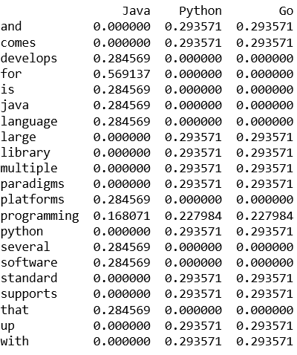
TF-IDF Example

Slide 48
4. Word2Vec
Word2Vec embedding approach, developed by Tomas Mikolov, is considered the state of the art.
Word2Vec approach uses deep learning and neural networks-based techniques to convert words into corresponding vectors in such a way that semantically similar vectors are close to each other in N-dimensional space, where N refers to the dimensions of the vector.
Word2Vec returns some astonishing results.
Word2Vec's ability to maintain semantic relation is reflected by a classic example:
If you have a vector for the word "King" and you remove the vector represented by the word "Man" from the "King" and add "Women" to it, you get a vector which is close to the "Queen" vector. This relation is commonly represented as:
King - Man + Women = Queen

Slide 49
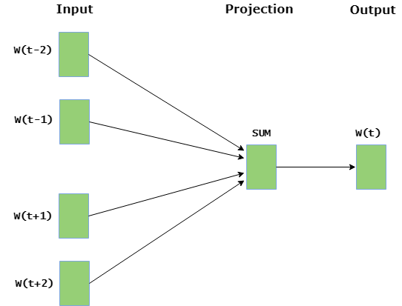
4. Word2Vec
These models are shallow two layer neural networks having one input layer, one hidden layer and one output layer.
Word2Vec utilizes two architectures :
(i) CBOW (Continuous Bag of Words) :
CBOW model predicts the current word given context words within specific window.
The input layer contains the context words and the output layer contains the current word.
The hidden layer contains the number of dimensions in which we want to represent current word present at the output layer.

Slide 50
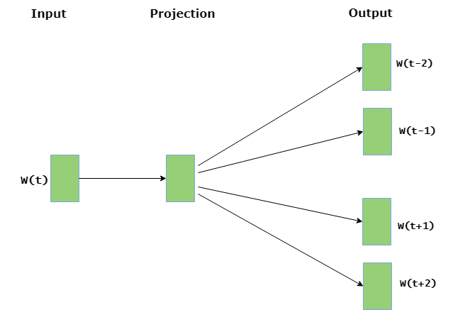
4. Word2Vec
(ii) Skip Gram :
Skip gram predicts the surrounding context words within specific window given current word.
The input layer contains the current word and the output layer contains the context words.
The hidden layer contains the number of dimensions in which we want to represent current word present at the input layer.
The basic idea of word embedding is words that occur in similar context tend to be closer to each other in vector space.
For generating word vectors in Python, modules needed are nltk and gensim.

Slide 51
Word Embedding using Word2Vec
https://www.geeksforgeeks.org/python-word-embedding-using-word2vec/
Book

Slide 52
Co-Occurrence Matrix with a fixed context window
The big idea – Similar words tend to occur together and will have similar context
For example – Apple is a fruit. Mango is a fruit. Apple and mango tend to have a similar context i.e. fruit.
How a co-occurrence matrix is constructed:
Using two concepts– Co-Occurrence and Context Window.
Co-occurrence – For a given corpus, the co-occurrence of a pair of words say w1 and w2 is the number of times they have appeared together in a Context Window
Context Window – Context window is specified by a number and the direction

Slide 53
Co-Occurrence Matrix with a fixed context window
The green words are a 2 (around) context window for the word ‘Fox’ and for calculating the co-occurrence only these words will be counted.
Context window for the word ‘Over’.

Slide 54
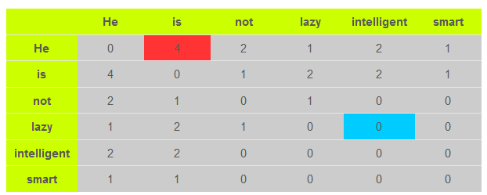
Co-Occurrence Matrix with a fixed context window
Example corpus to calculate a co-occurrence matrix
Corpus = He is not lazy. He is intelligent. He is smart.

Slide 55
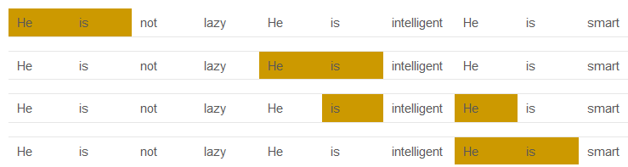
Co-Occurrence Matrix with a fixed context window
Red box- It is the number of times ‘He’ and ‘is’ have appeared in the context window 2 and it can be seen that the count turns out to be 4
The below table will help you visualize the count
The word ‘lazy’ has never appeared with ‘intelligent’ in the context window and therefore has been assigned 0 in the blue box

Slide 56
Variations of Co-occurrence Matrix
Consider V unique words in the corpus. So Vocabulary size = V.
The columns of the Co-occurrence matrix form the context words.
The different variations of Co-Occurrence Matrix are:
A co-occurrence matrix of size V X V.
Even for a decent corpus V gets very large and difficult to handle.
This architecture is never preferred in practice.
A co-occurrence matrix of size V X N where N is a subset of V and can be obtained by removing irrelevant words like stopwords etc. for example.
This is still very large and presents computational difficulties
This co-occurrence matrix is not the word vector representation
Instead, this Co-occurrence matrix is decomposed using techniques like PCA, SVD etc. into factors and combination of these factors to form the word vector representation
For example, you perform PCA on the above matrix of size VXV. You will obtain V principal components
You can choose k components out of these V components. So, the new matrix will be of the form V X k

Slide 57
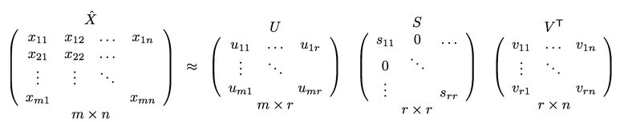
Variations of Co-occurrence Matrix
A single word, instead of being represented in V dimensions will be represented in k dimensions while still capturing almost the same semantic meaning
So, what PCA does at the back is decompose Co-Occurrence matrix into three matrices, U,S and V
What is of importance is that dot product of U and S gives the word vector representation and V gives the word context representation

Slide 58
N-gram Language Model
The language model which is based on determining probability based on the count of the sequence of words can be called as N-gram language model.
The sequence of words can be 2 words, 3 words, 4 words…n-words etc.
Based on the count of words, N-gram can be:
Unigram: Sequence of just 1 word
Bigram: Sequence of 2 words
Trigram: Sequence of 3 words
…so on and so forth

Slide 59
Unigram Language Model Example
Let’s say we want to determine the probability of the sentence, “Which is the best car insurance package”
Based on Unigram language model, probability can be calculated as following:
P(“Which is best car insurance package”)= P(which)P(is)…P(insurance)P(package)
Above represents product of probability of occurrence of each of the words in the corpus. The probability of any word, wi can be calcuted as following:
P(wi)=c(wi)/c(w)
where wi is ith word, c(wi) is count of wi in the corpus, and c(w) is count of all the words.

Slide 60

Bigram Language Model Example
Using Bigram language model, the probability can be determined as following:
P(“Which is best car insurance package”)= P(which/startOfSentence)P(is/which)P(best/is)..P(endOfSentence/package)
The following represents example of how to calculate each of the probabilities:
P(car/best)=P(best car)/P(best)
The above can also be calculated as following:
P(car/best)= c(best car)/c(best)
The above could be read as: Probability of word “car” given word “best” has occurred is probability of word “best car” divided by probability of word “best”.
Alternatively, Probability of word “car” given word “best” has occurred is count of word “best car” divided by count of word “best”.
The probability of any word given previous word, wi/wi−1 can be calculated as following:

